Slide 1
Convolutional Neural Networks

Slide 2
Outline
What is a CNN
Convolution
Max Pooling
Putting It All Together
Final Remarks

Slide 3
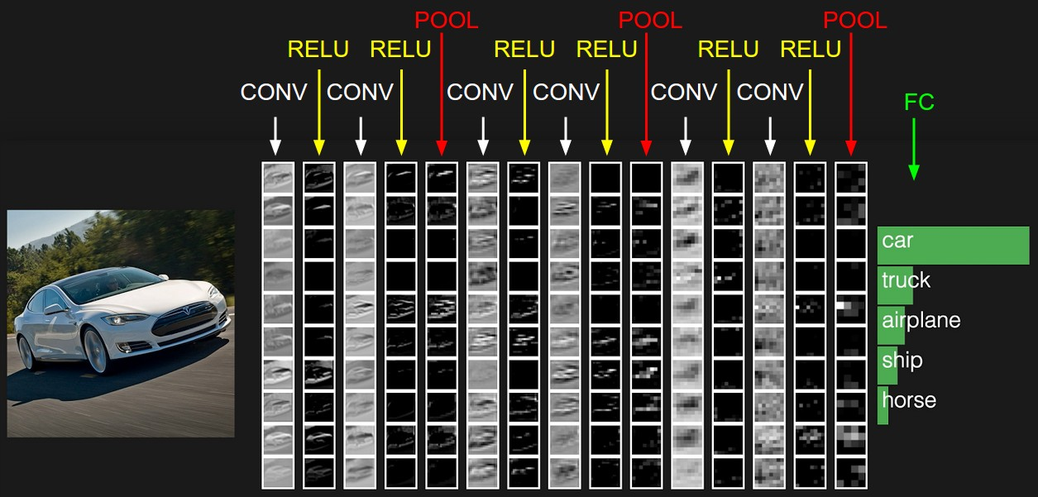
What is a CNN

Slide 4
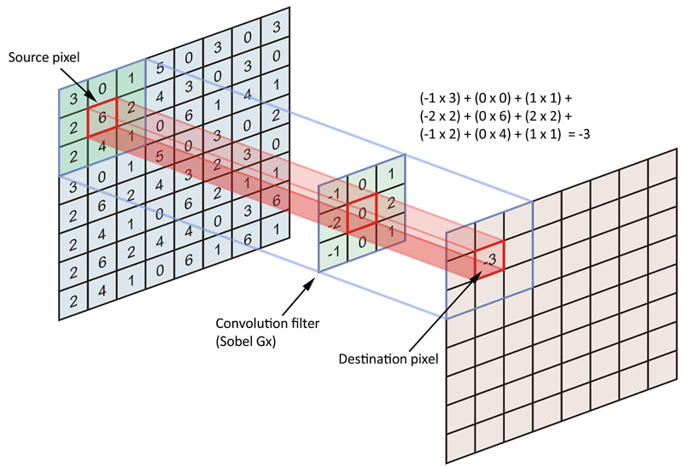
Convolution

Slide 5
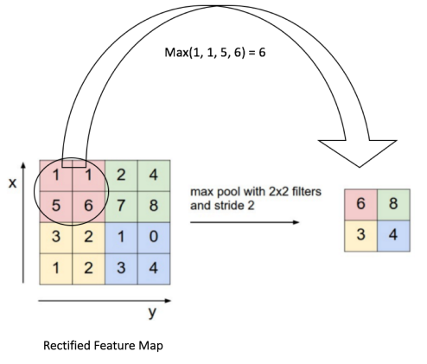
Max Pooling

Slide 6
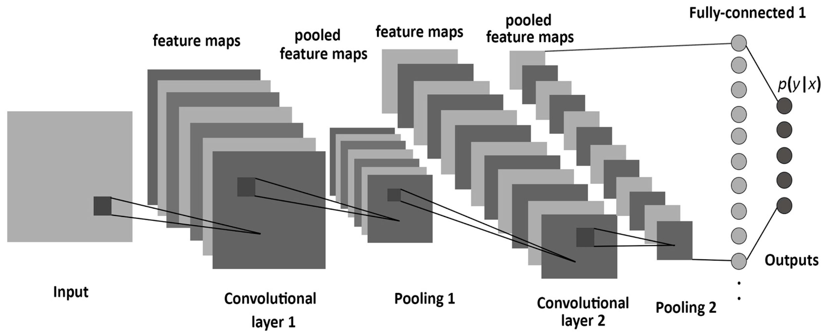
Putting It All Together

Slide 7
Final Remarks
CNNs were inspired by human vision
Pooling is used to retain the most important features while minimizing computation
Also used to perform computations on sequential data as well as graphs

Slide 8
Questions?

Slide 9
References
https://github.com/pjreddie/cnn-primer/tree/master/1
https://michelleful.github.io/PyCon2017/#/
http://cs231n.github.io/convolutional-networks/
https://www.mdpi.com/1099-4300/19/6/242

